Slide 1
Internship
Report & project review-2
INTERNSHIP PERIOD: 7 - Jule -2025 / 21 – August - 2025
STUDENT NAME : Bramhendra C
ROLLNO- 23691A282 - III CST SEC - A
REVIEW DATE : 22-10-2025
INTERNSHIP MENTOR: Mr. P.Lakshmi Ramana

Slide 2
ABOUT INDUSTRY/ORGANIZATION DETAILS
Company Name: ELiteTech Intern
Founder: Adarsh
Website: elitetechintern.com
Establishment Year: 2024
Description of Services: ELiteTech Intern is an IT Service company that provides a 6-week
internship program in the field of Artificial Intelligence.
Address: The provided certificate does not contain a physical address for the company.

Slide 3
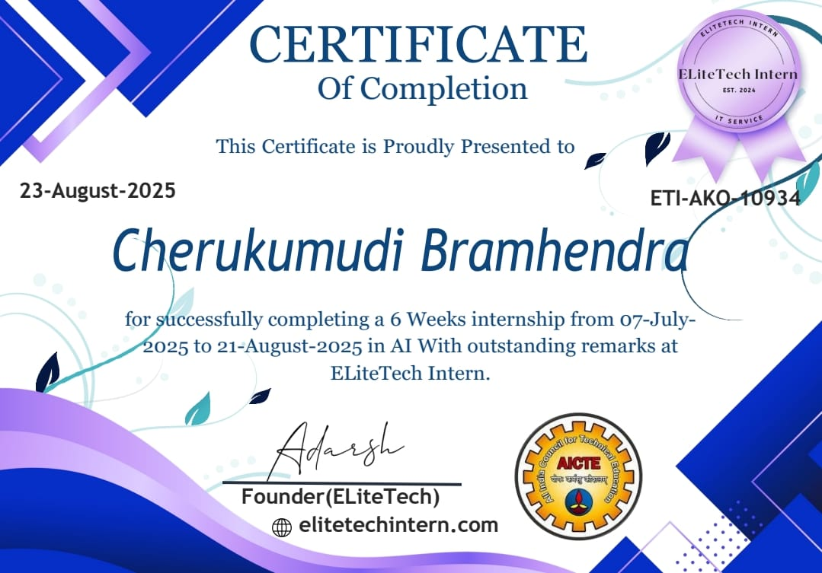
Internship Certificate

Slide 4
My Internship
Internship Description
VisionVoice: A Python-based AI assistant integrating Voice Control and Computer Vision (CV) to enhance user productivity.
The system performs real-time face detection and user focus tracking, providing immediate auditory and visual feedback.
Seamlessly fetches external data, including weather reports, via API integration while maintaining concurrent video processing.
Things learned
NLP , Computer Vision, API integration, Modular Programing.

Slide 5
SPECIFIC TASKS
Area | Key Tasks & Achievements
Computer Vision (CV) | Real-Time Face Detection (OpenCV/Haar Cascades) and Focus State Tracking.
Voice/AI | Implemented Speech Recognition and Text-to-Speech (TTS) for system feedback and command processing.
Integration | Developed a Concurrent Architecture (Threading) to run vision and listening simultaneously.
APIs | Integrated external APIs (e.g., weather) to deliver dynamic, voice-requested information.

Slide 6
The Project Proposal
Problem & Solution
Problem: User distraction and lack of real-time productivity feedback.
Solution: Develop VisionVoice, a Python AI Assistant combining Computer Vision and Voice Control for real-time focus monitoring and intervention
Goal:
Build a responsive, integrated system to actively manage and improve user focus.

Slide 7
Title of your project
VisionVoice – An Intelligent Focus Tracking and Voice Command System

Slide 8
Objective of your project
To develop and integrate a Python AI Assistant that uses Computer Vision (face detection) and Voice Control to provide real-time focus monitoring and proactive interventions, thereby improving user productivity.

Slide 9
Abstract
VisionVoice is a Python AI Assistant combining Computer Vision (CV) and Voice Control to enhance productivity. It performs real-time face detection to track user focus and utilizes NLP for voice commands and API-based data retrieval. The system runs on a concurrent, modular architecture, providing proactive, audio-visual feedback based on the user's focus state..

Slide 10
Existing system with its disadvantages
Existing System
Standard Voice Assistants: Systems like Google Assistant or Siri.
Separate Face Detection Software: Standalone Computer Vision (CV) programs.
Disadvantages
Voice Assistants - Purely Reactive: They wait for commands and lack awareness of the user's physical presence or attention.
Vision Systems - Passive: They perform monitoring but do not offer interactive, voice-based functionality.
Integration - Lack of Integration between the voice (input/output) and vision (monitoring) modes.

Slide 11
Proposed system with advantages
Proposed System
A single, unified application that integrates both voice control and vision-based attention tracking (VisionVoice).
Key Advantages
Multi-Modal: The user can interact actively using voice while the system passively monitors their visual presence via the webcam.
Attention Awareness: The "unfocused counter" provides a novel metric for measuring productivity, e-learning engagement, or proctoring, a feature standard voice assistants lack.
Modular: The system is built with separate files for each core function, making it easy to maintain and expand (e.g., adding new AI features).

Slide 12
Hardware & Software Requirements
Hardware
Computer (PC or Laptop)
Webcam (for face detection)
Microphone (for voice commands)
Speakers (for assistant's voice)
Software
OS: Windows, macOS, or Linux
Language: Python 3.x
Key Libraries: opencv-python (cv2), speechrecognition, pyttsx3, pygame, wikipedia, pyjokes, requests.

Slide 13
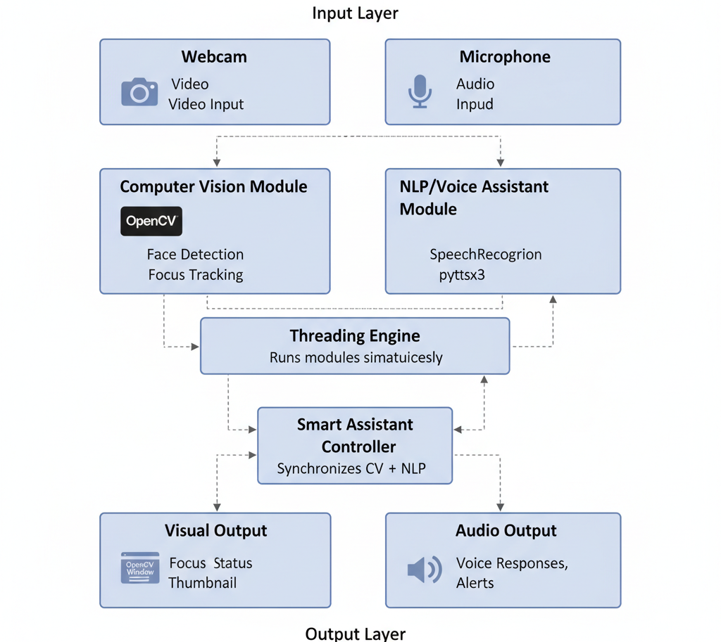
System Architecture

Slide 14
Methodologies Used for Implementation
Modular Programming: Structured code into independent, reusable modules.
Event-Driven: System reacts to CV (focus changes) and Voice (commands) events.
Concurrency (Threading): Enabled simultaneous Vision processing and Voice listening.
API Integration: Incorporated external services for dynamic data.
Iterative Development: Built functionalities incrementally.

Slide 15
List of Modules
Face Detection Module
Focus Tracking Module
Voice Assistant Module
Smart Assistant Module
Application Launcher Module
Utility & Helper Functions Module

Slide 16
Sample Program Code for Explanation
import speech_recognition as sr
import pyttsx3
import datetime
engine = pyttsx3.init()
listener = sr.Recognizer()
def speak(text):
engine.say(text)
engine.runAndWait()

Slide 17
Sample Program Code for Explanation
def take_command():
with sr.Microphone() as source:
audio = listener.listen(source)
return listener.recognize_google(audio)
while True:
command = take_command().lower()
if "time" in command:
time_now = datetime.datetime.now().strftime("%H:%M:%S")
speak(f"The time is {time_now}")

Slide 18
Sample Program Code for Explanation
elif "joke" in command:
speak("Why don't robots get tired? Because they recharge!")
elif "stop" in command:
speak("Goodbye!")
break

Slide 19
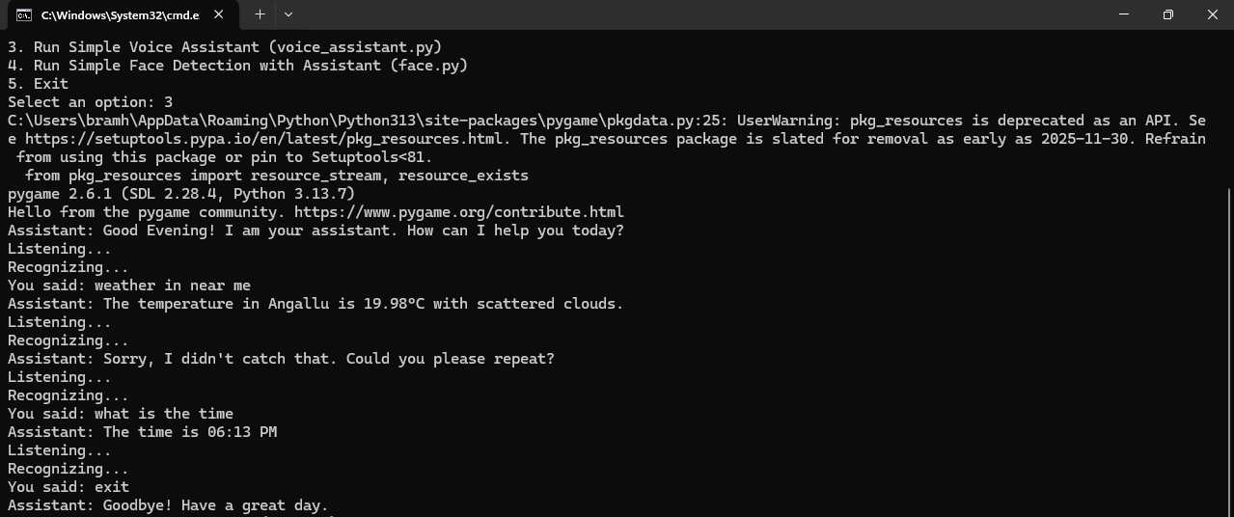
Sample Screen Shots

Slide 20
References
OpenCV: For Computer Vision (face detection).
SpeechRecognition & pyttsx3: For Voice Input (STT) and Output (TTS).
Requests & Wikipedia/PyJokes: For API Integration and dynamic content.
Python threading module: For concurrent execution of vision and voice.
General AI/ML Principles: Underlying concepts for intent classification and real-time processing.

Slide 21
Conclusion
This project successfully demonstrates the creation of a hybrid AI application by integrating computer vision with natural language processing. The system provides a practical tool that is not only reactive (through voice) but also aware of the user's presence (through vision). The "unfocus counter" serves as a simple yet effective proof-of-concept for building more advanced, attention-aware software for fields like e-learning and personal productivity.
GitHub Link : https://github.com/Bramhendra-C/VisionVoice-AI/

Slide 22
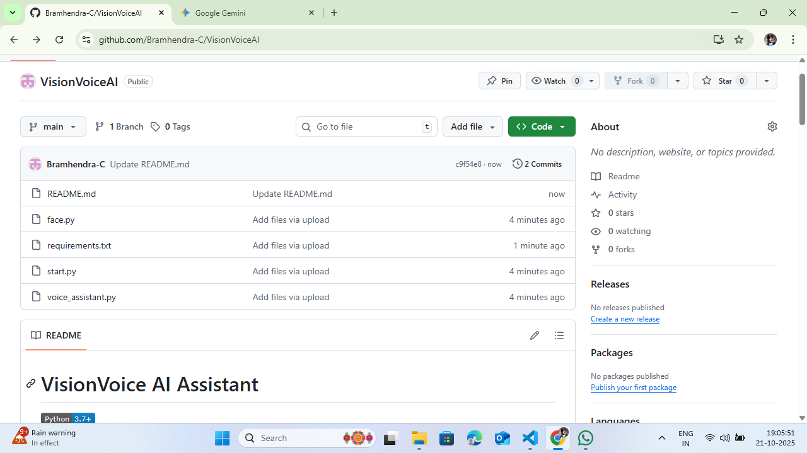
Proof : Uploaded in GitHub

Slide 23
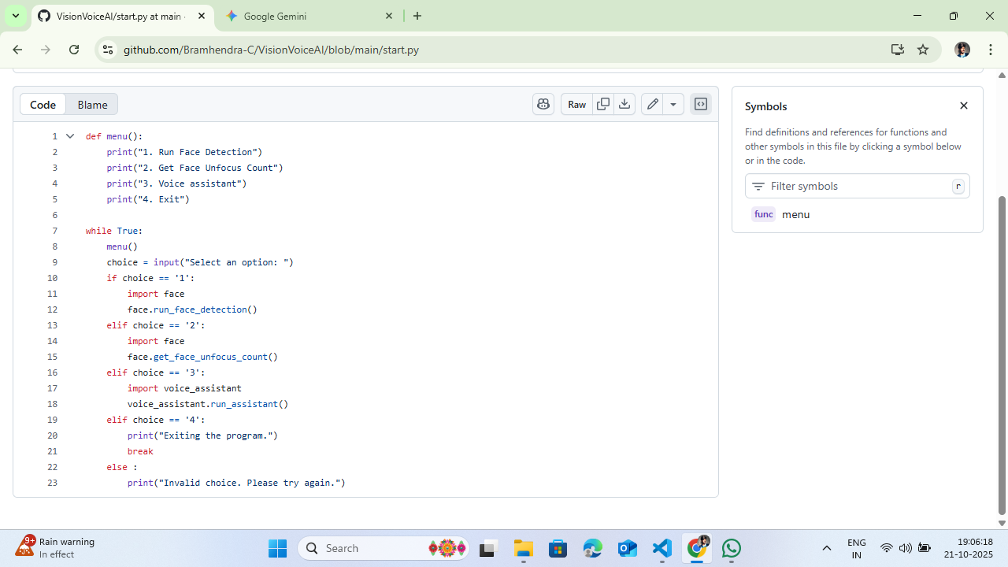
Proof : Uploaded in GitHub

Slide 24
Thank You Sir

